Slide 1



Digital Book Hub
Galgamuge Emmanuel Fernando - C0918066
Vihangi Kolamunna - C0903980
Chris Mary Bulatao - C0908671
William Binitie - C0906287
Yolimar Rios - C0904675
Notes:
Yolimar

Slide 2



Introduction
Notes:
Yolimar

Slide 3
What is DigitalBookHub?
DigitalBookHub is an online public platform that offers users access to a diverse array of digital books, e-books, and other digital publications. It provides a centralized location for users to find, or access a wide range of digital books. Users also has the ability to upload books into the system.
Notes:
Yolimar

Slide 4
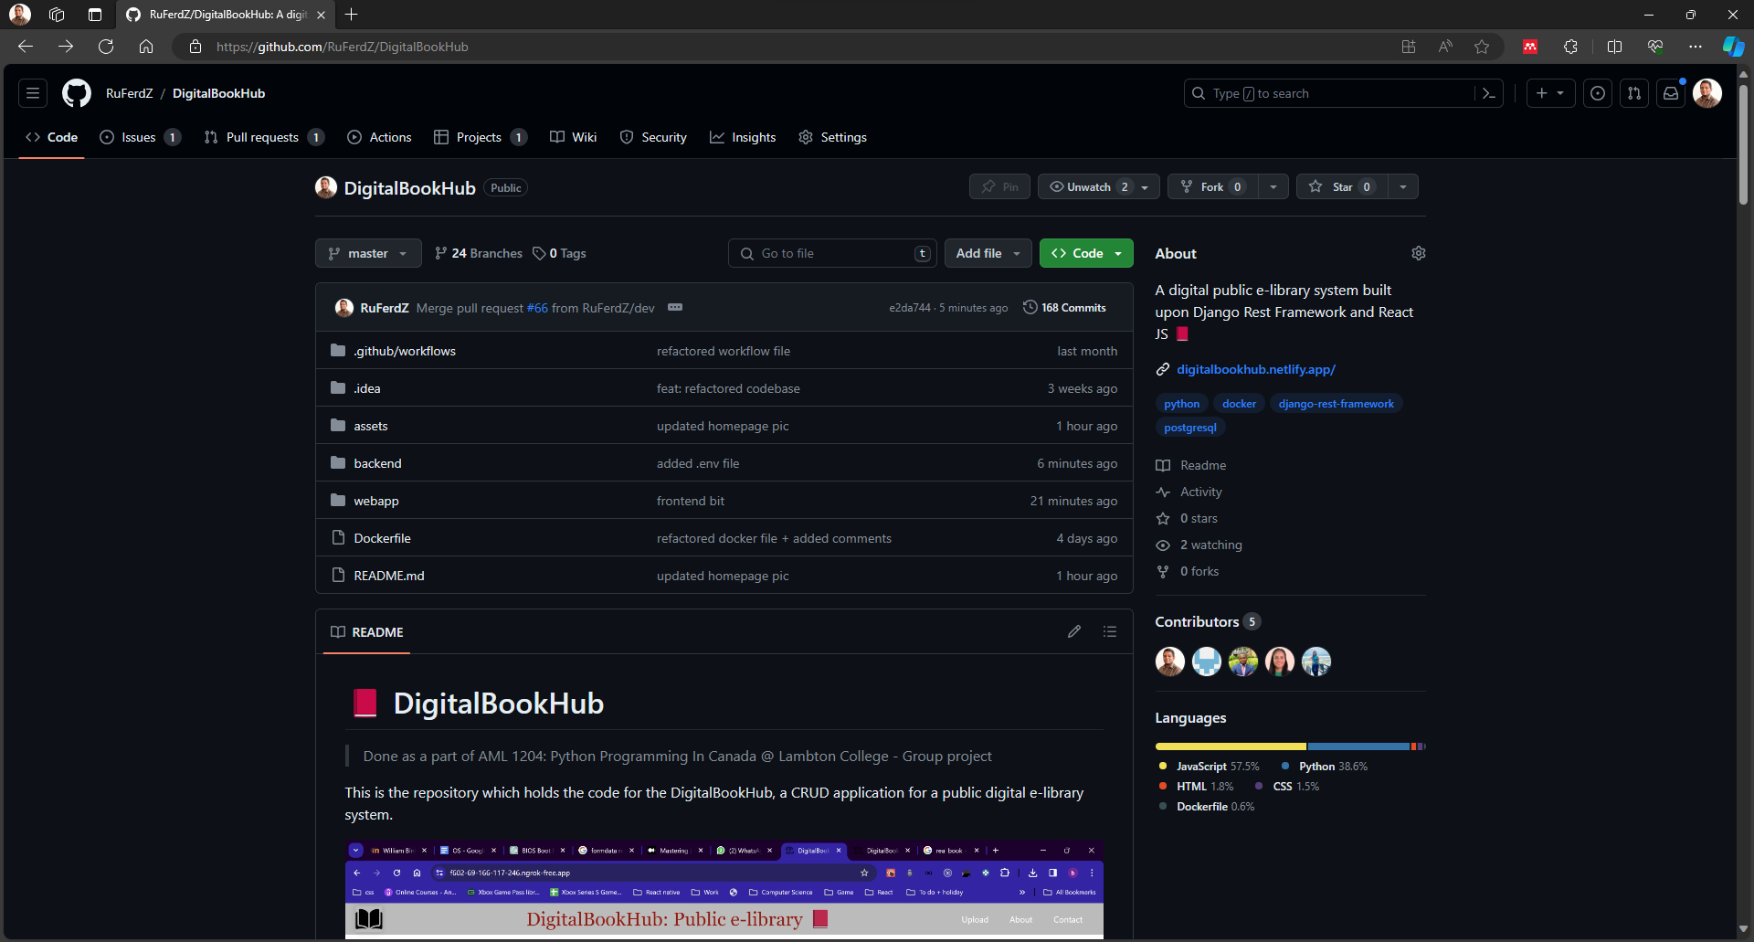
GitHub Repository
Link: https://github.com/RuFerdZ/DigitalBookHub
Notes:
Yolimar

Slide 5
Tools & Technologies
Notes:
Yolimar

Slide 6

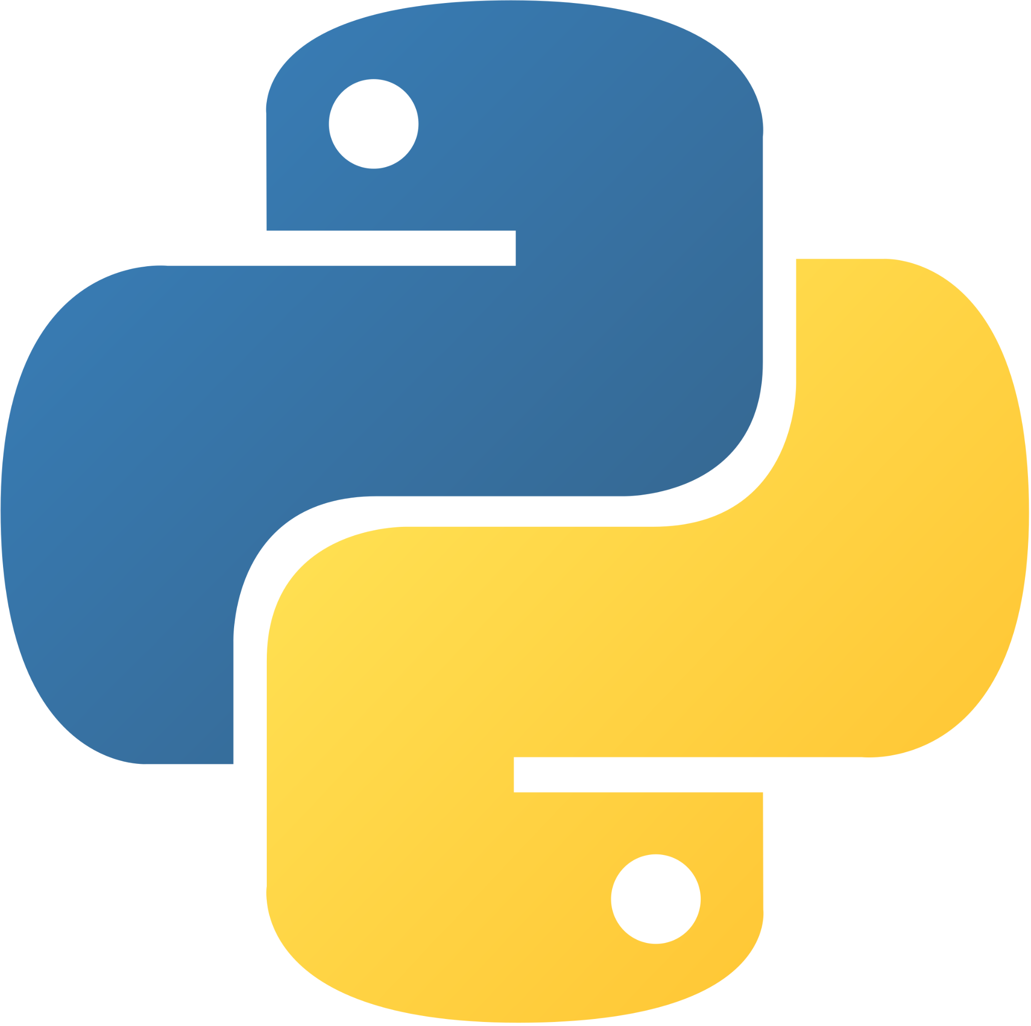





Django Rest Framework
Python
Microsoft Azure
PostgreSQL
GitHub Workflows
GitHub
Docker
Notes:
Yolimar

Slide 7
Features of Django Rest Framework
Serialization
Authentication and Authorization
Browsable API
Class-Based Views
Extensions and Third-Party Packages
Notes:
Yolimar

Slide 8
Project Management
Notes:
Chris

Slide 9
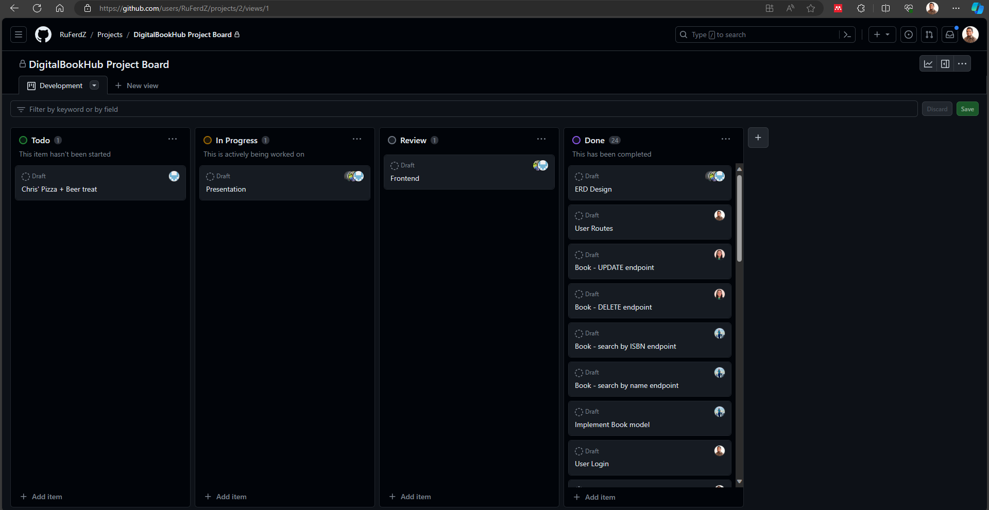
GitHub Projects
Notes:
Chris

Slide 10
System Design
Notes:
Chris

Slide 11
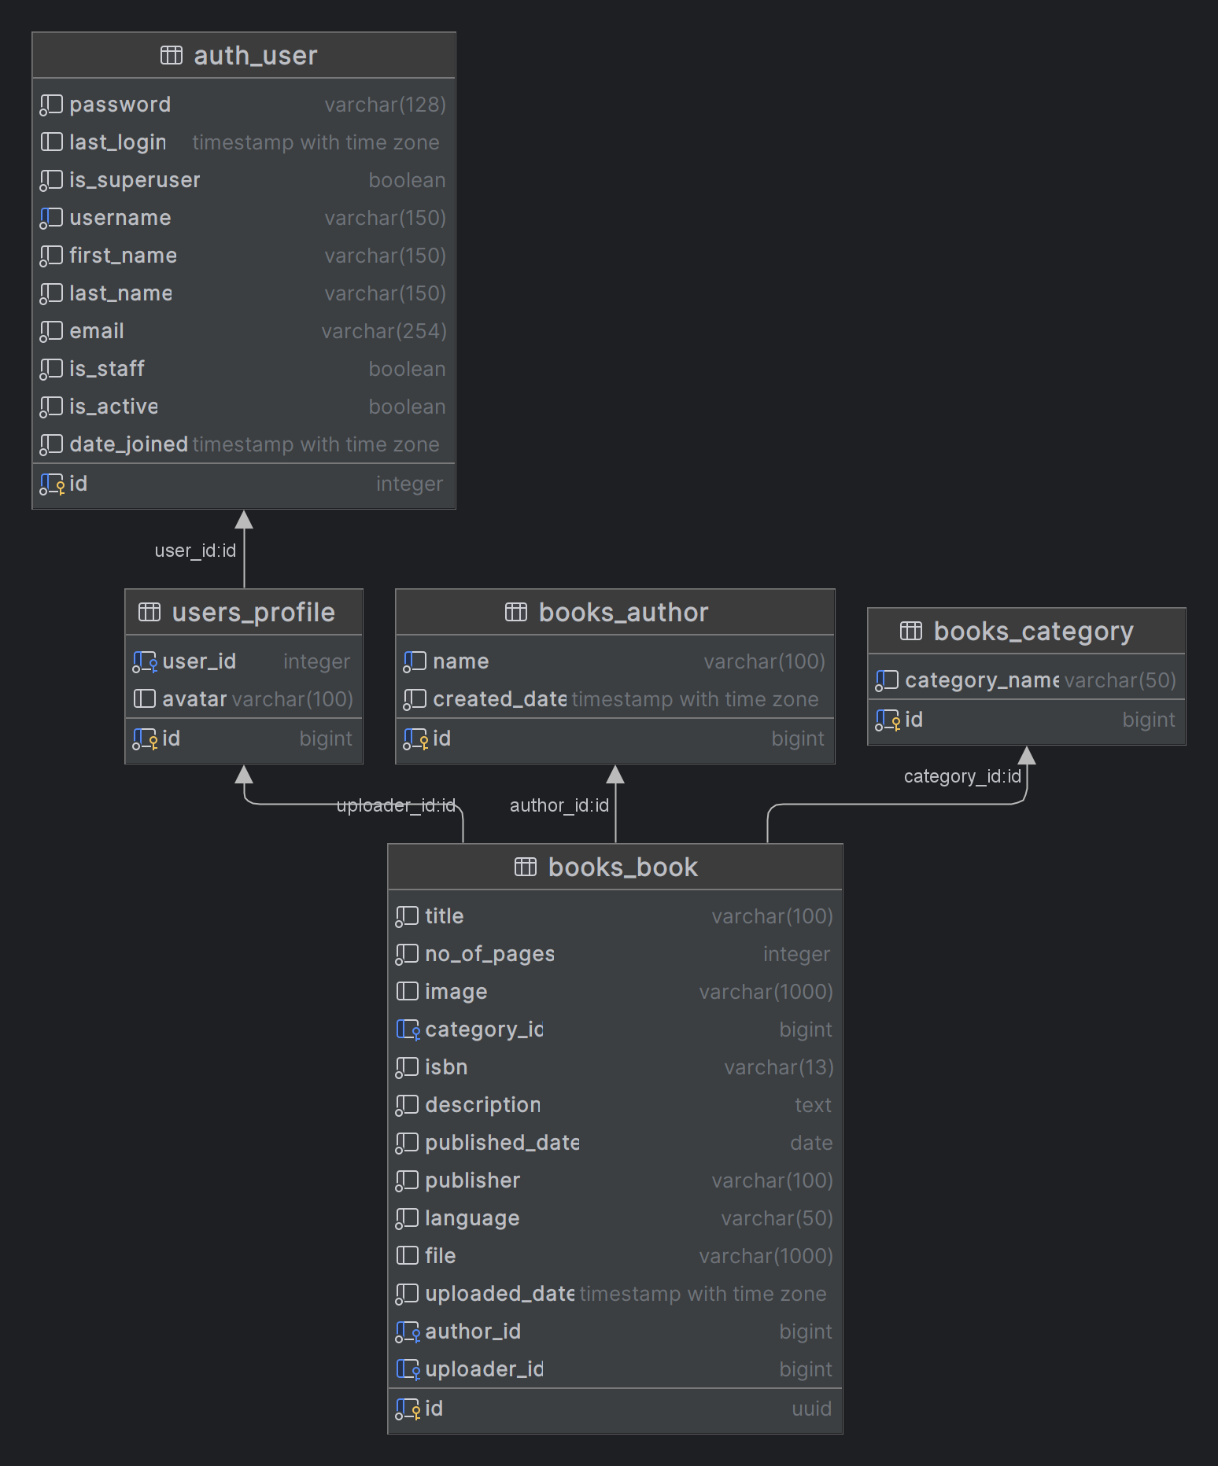
Class
Diagram
Notes:
Chris

Slide 12
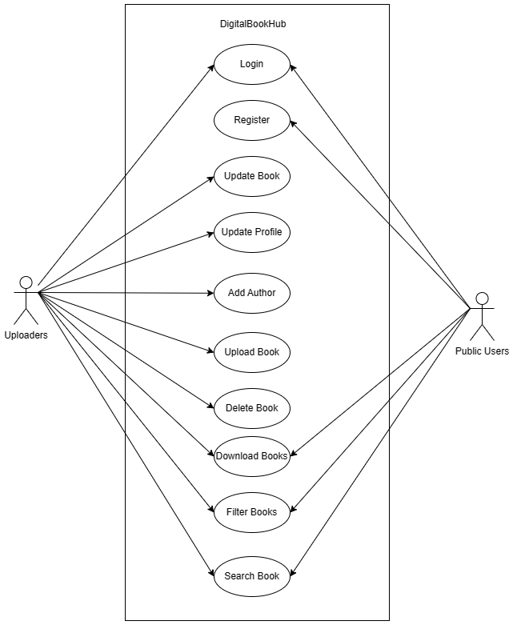
Use-case
Diagram
Notes:
Chris

Slide 13
Let’s get into Coding!
Notes:
Vihangi

Slide 14
Python Libraries & Modules
Django
djangorestframework
psycopg2-binary
django-rest-framework-social-oauth2
django-cors-headers
drf_yasg
Notes:
Vihangi
Django & djangorestframework = backend libraries + frameworks
Psycopg2-binary = used to connect to postgres database
Django-rest-framework-social-oauth2 = used to authenticate users
Django-cors-headers = for handling the server headers required for Cross-Origin Resource Sharing (CORS)
Drf_yasg = used to generate API documentation such as Swagger

Slide 15
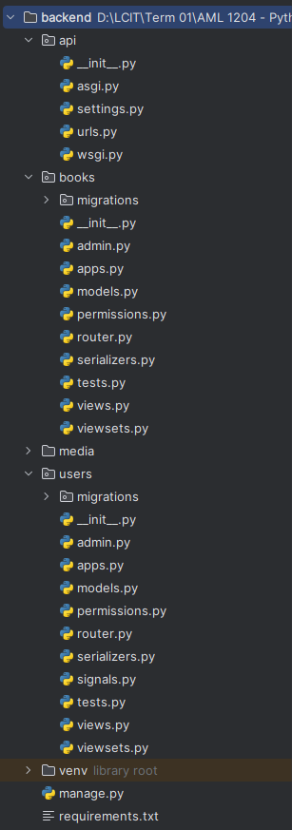
Project Structure
Notes:
How the python app is structured. The Apps we used are books and users

Slide 16
Models
Notes:
Vihangi

Slide 17
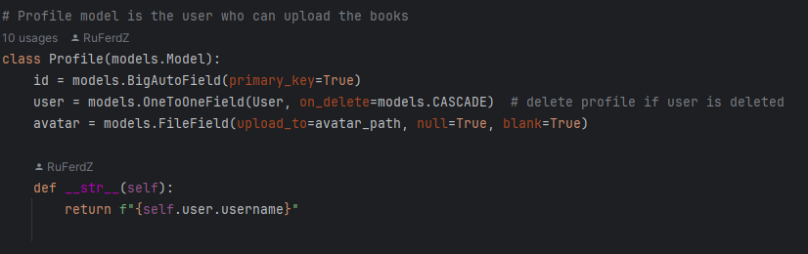
Profile Model
Notes:
Vihangi
In the models, Data type matched to pass arguments.

Slide 18
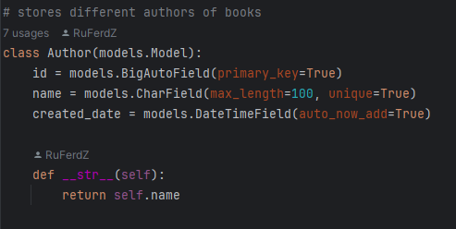
Author Model
Notes:
Vihangi

Slide 19
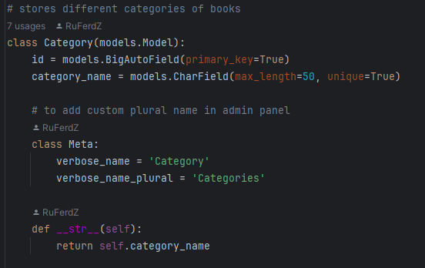
Category Model
Notes:
Vihangi

Slide 20
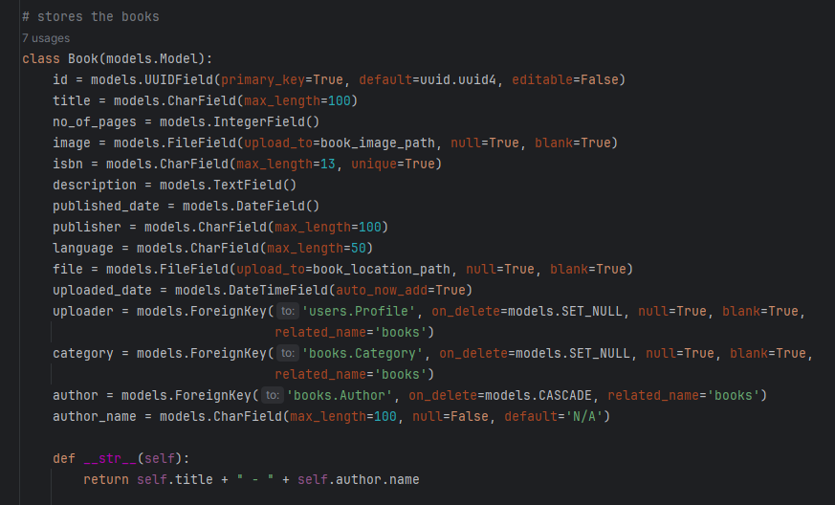
Book Model
Notes:
Vihangi

Slide 21
Database
Configuration
Notes:
Vihangi

Slide 22
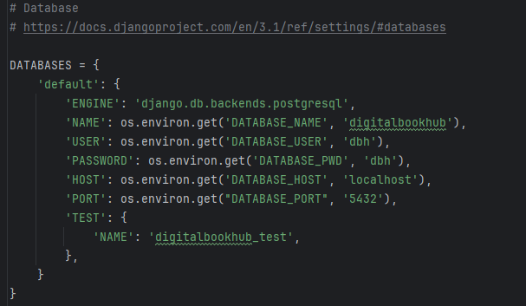
settings.py
Notes:
Vihangi

Slide 23
Security
Notes:
Rusiru

Slide 24
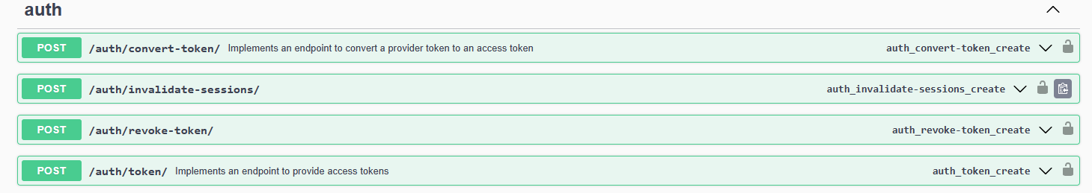
Library
django-rest-framework-social-oauth2
Notes:
Rusiru

Slide 25
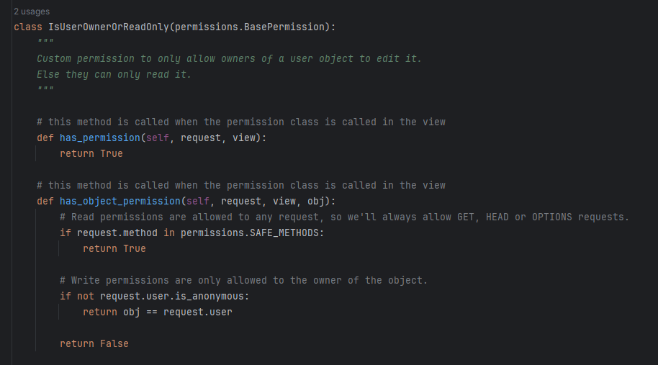
permissions.py
Notes:
Rusiru

Slide 26
Django viewsets
Notes:
Rusiru

Slide 27
What are viewsets and why they are used?
In Django, a ViewSet is a class-based view that is used in conjunction with Django REST Framework (DRF) to handle HTTP methods (GET, POST, PUT, DELETE, etc.) for API endpoints.
ViewSets provide a way to organize the logic for different actions related to a resource (e.g., a model in your database) in a single class.
Notes:
Rusiru

Slide 28
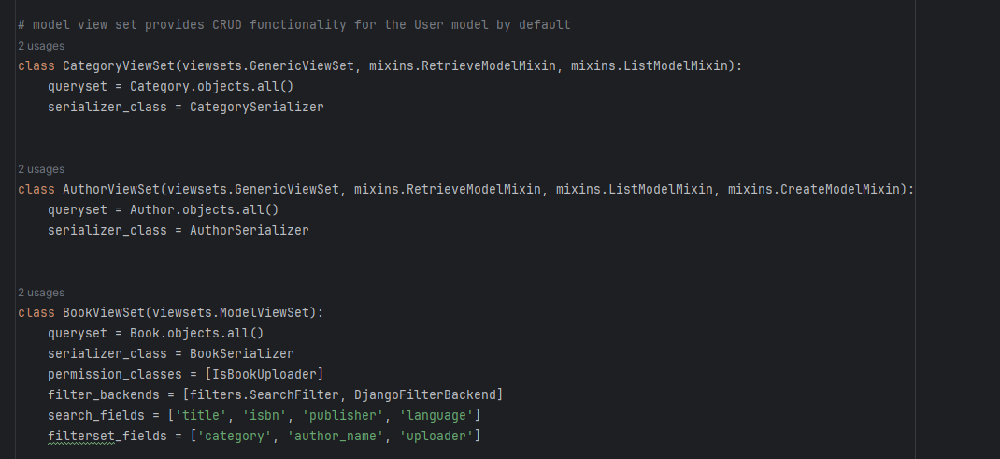
viewsets.py
Notes:
Rusiru

Slide 29
Django Serializers
Notes:
Rusiru

Slide 30
What are serializers and why they are used?
Serializers allow you to convert complex data types (like Django model instances) into native Python data types (typically dictionaries) that can be easily rendered into JSON or other content types. This is useful when you want to send data over an API.
Notes:
Rusiru

Slide 31
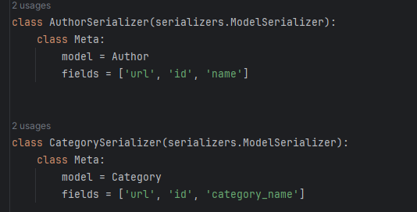
serializers.py
Notes:
Rusiru

Slide 32
Additional Features
Notes:
Rusiru

Slide 33
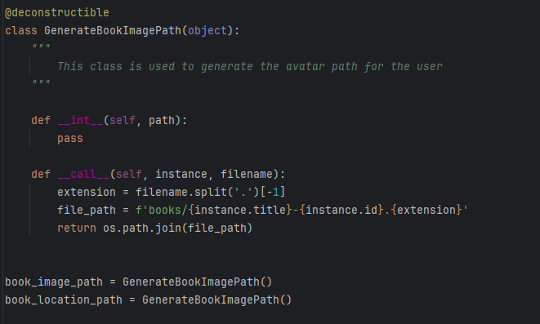
File uploading
Notes:
Rusiru

Slide 34
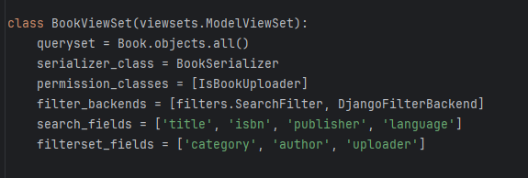
Filtering & Searching
Notes:
Rusiru

Slide 35
Routing
Notes:
Rusiru

Slide 36
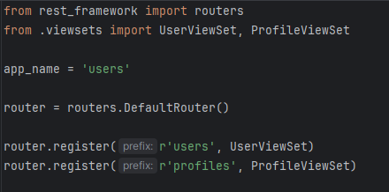
User Routing
Notes:
Rusiru

Slide 37
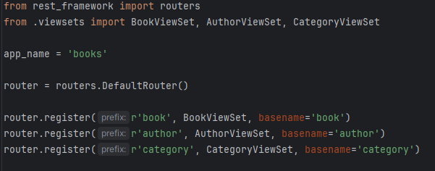
Books Routing
Notes:
Rusiru

Slide 38
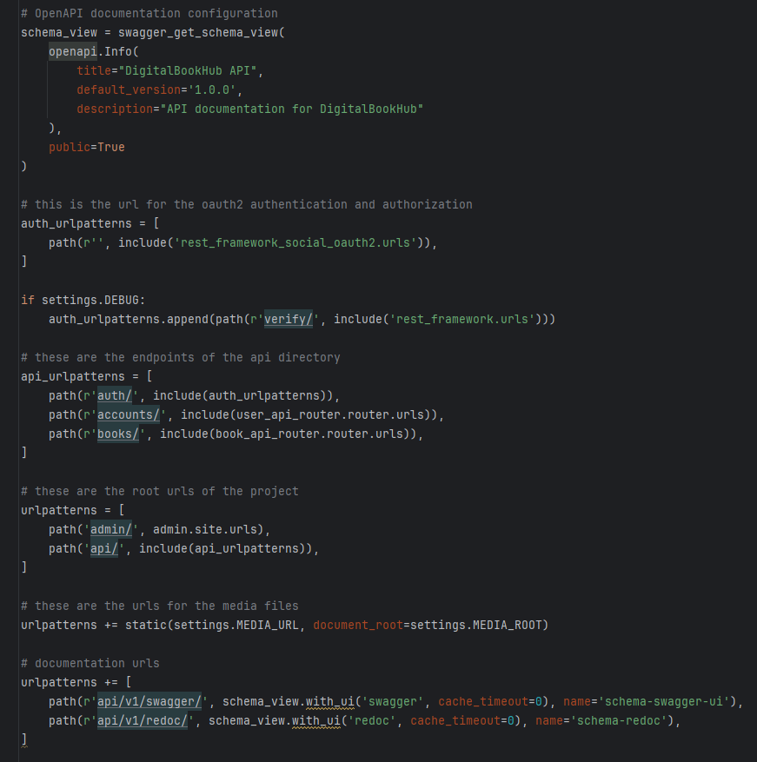
API Routing
Notes:
Rusiru

Slide 39
DevOps
Notes:
William

Slide 40
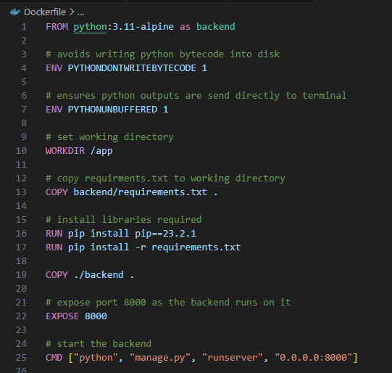
Docker File
Notes:
William

Slide 41
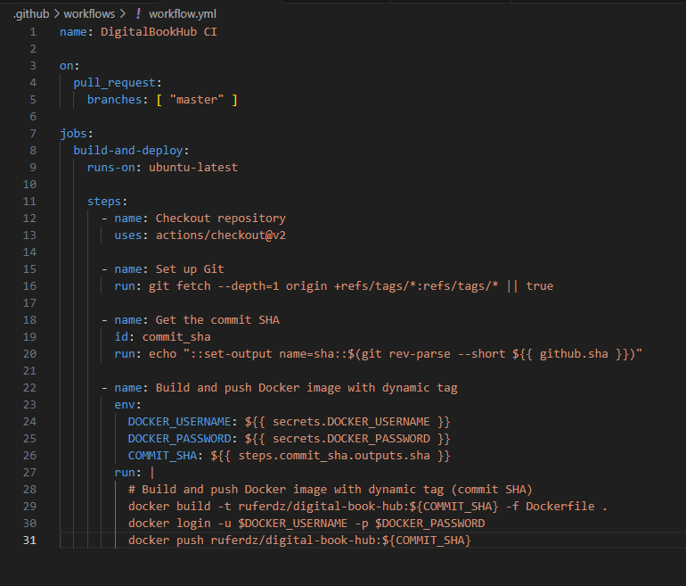
GitHub Actions (workflow.yml)
Notes:
William

Slide 42
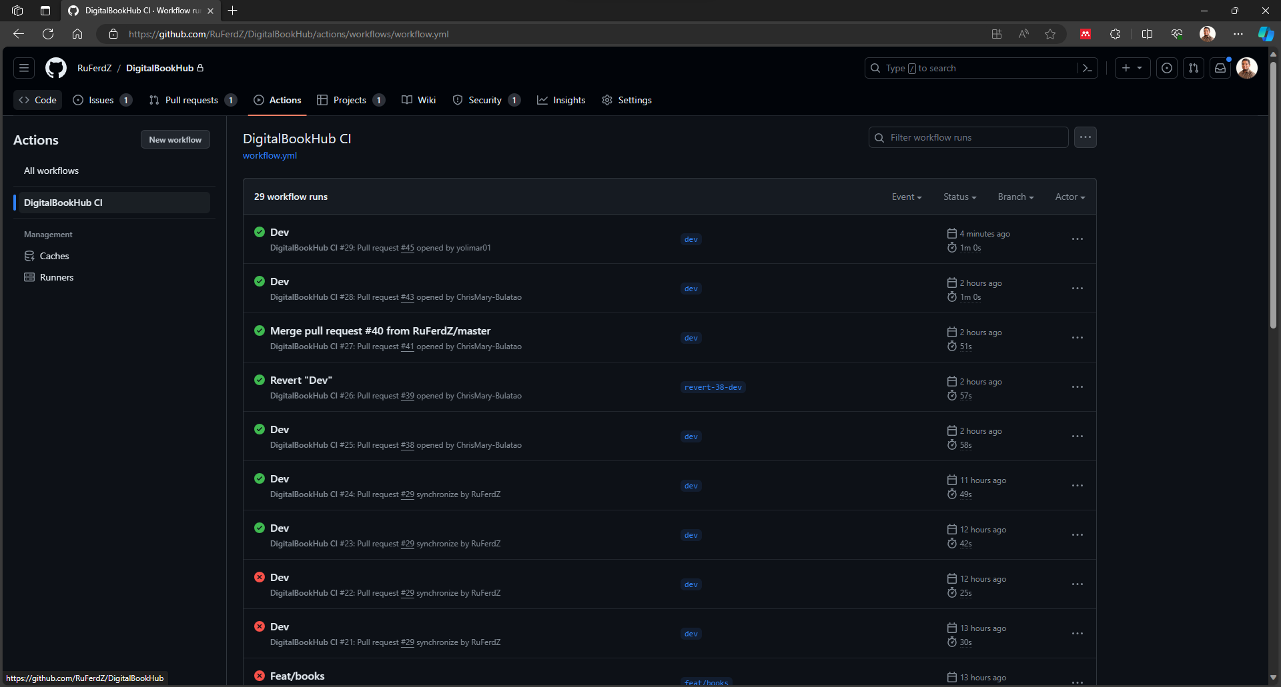
Workflow Runs
Notes:
William

Slide 43
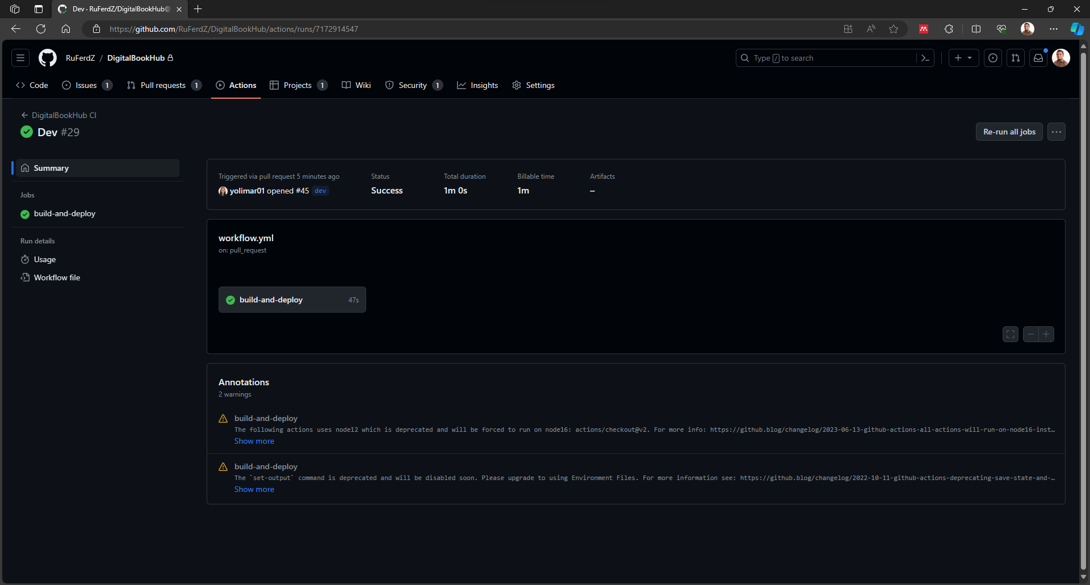
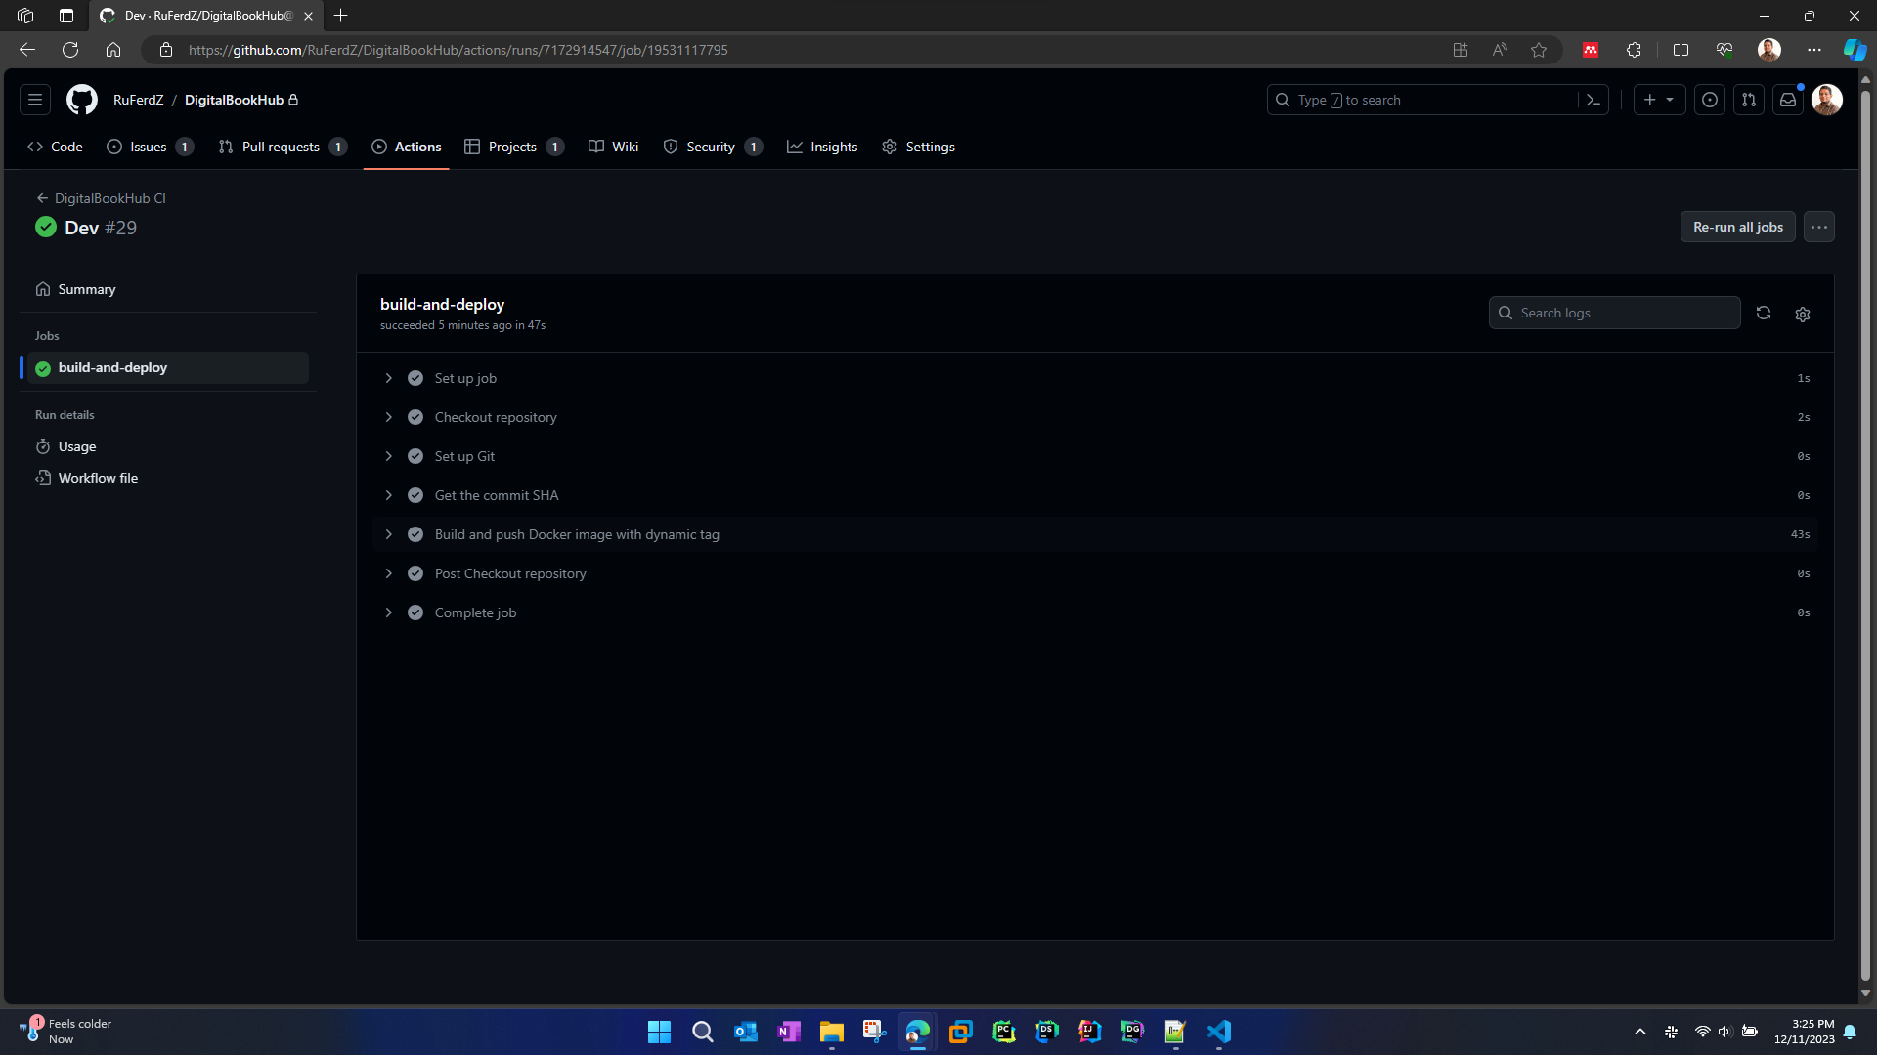
Single Workflow run
Notes:
William

Slide 44
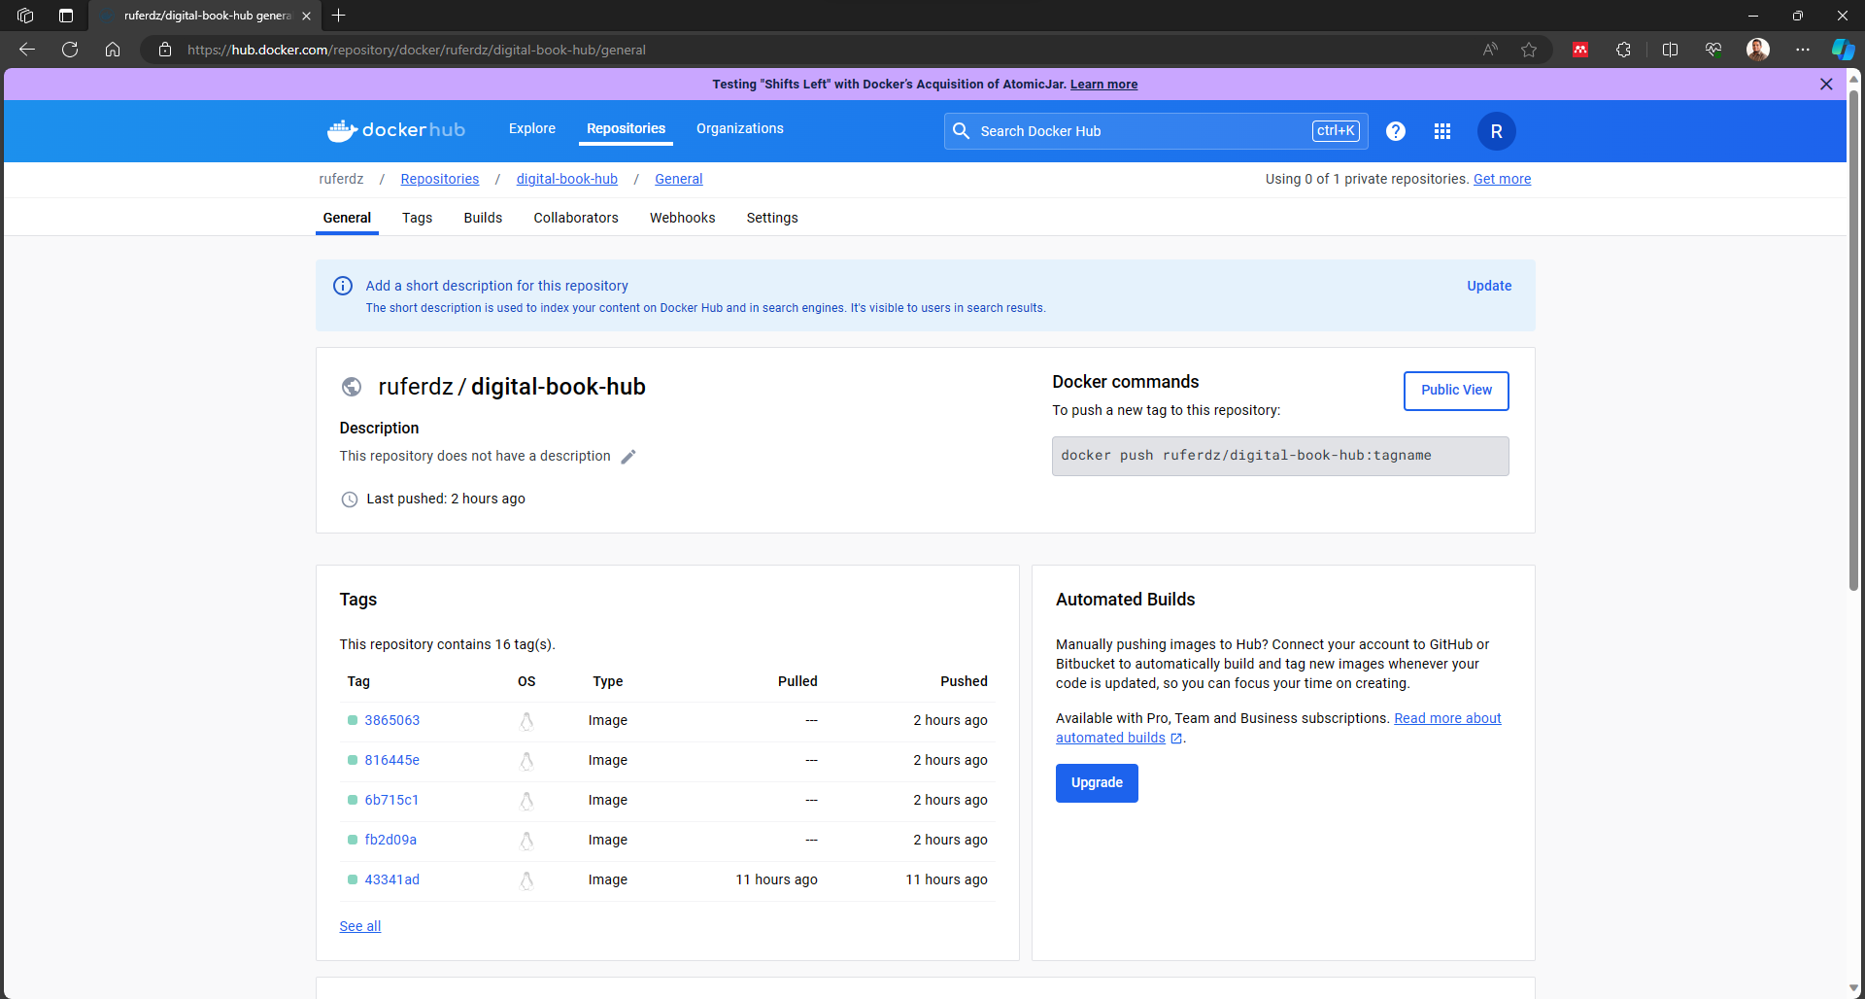
Docker Hub
Notes:
William

Slide 45
API Documentation
Notes:
Rusiru

Slide 46
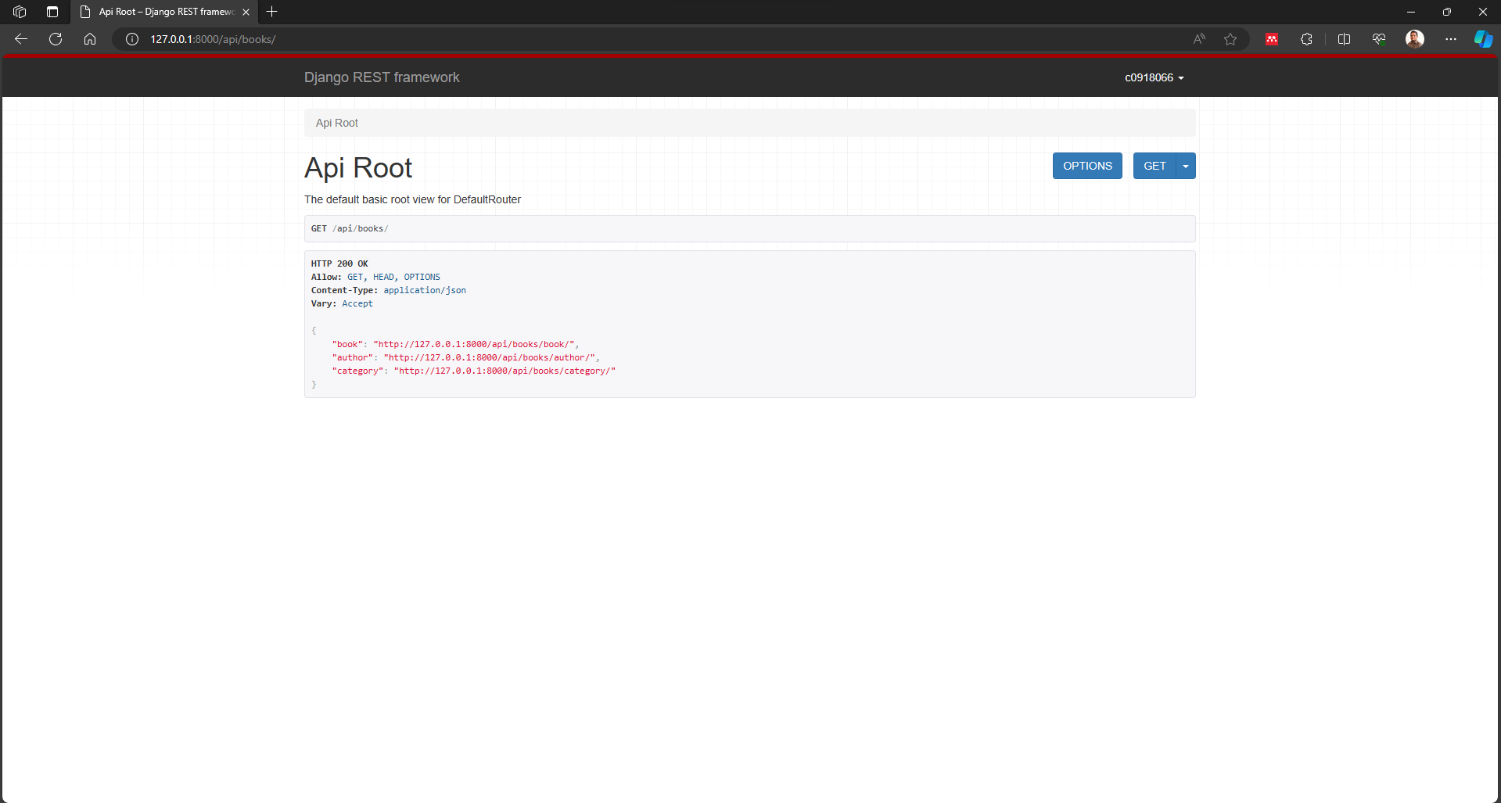
Django in-built Browsable API
Notes:
Rusiru

Slide 47
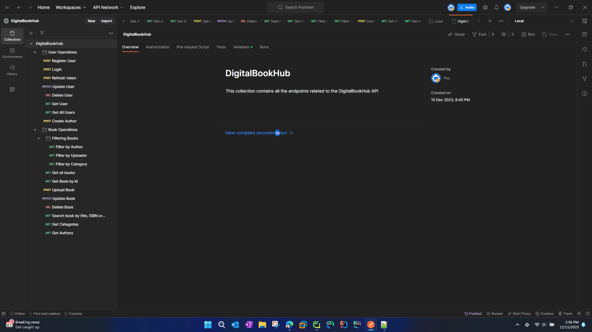
Postman
Notes:
Rusiru

Slide 48
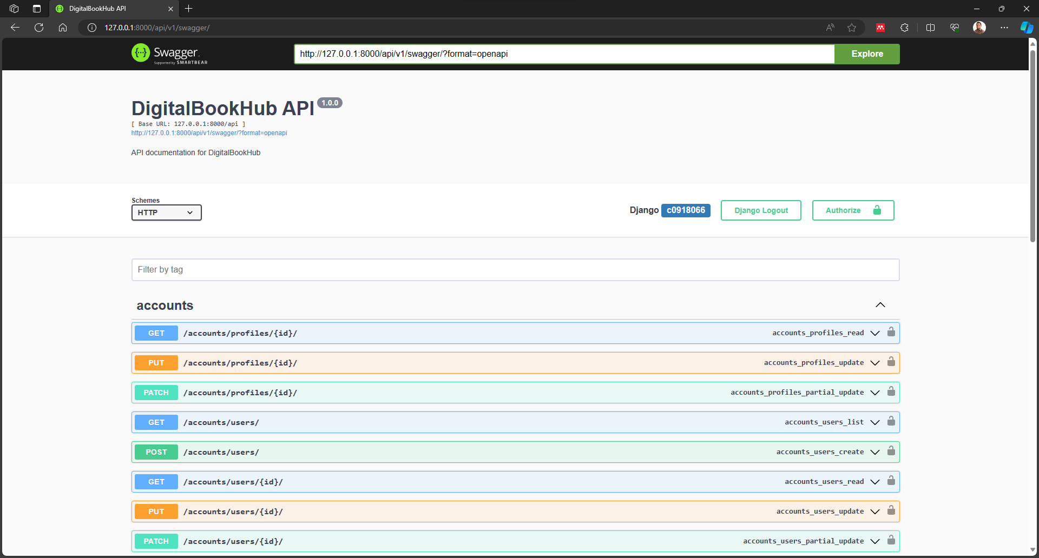
Swagger
Notes:
Rusiru

Slide 49
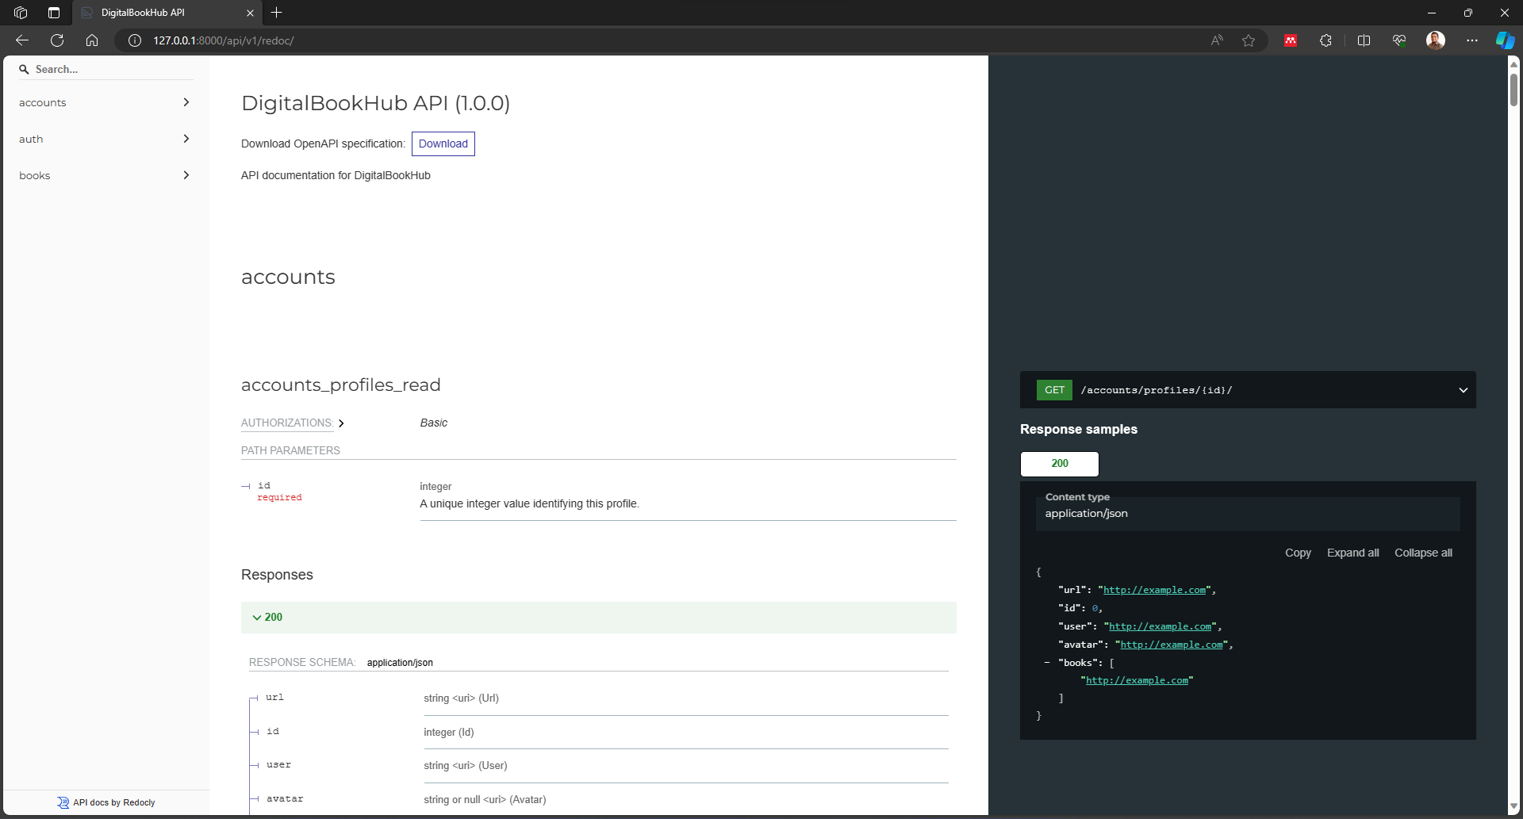
ReDoc
Notes:
Rusiru

Slide 50
Web App
Notes:
William

Slide 51
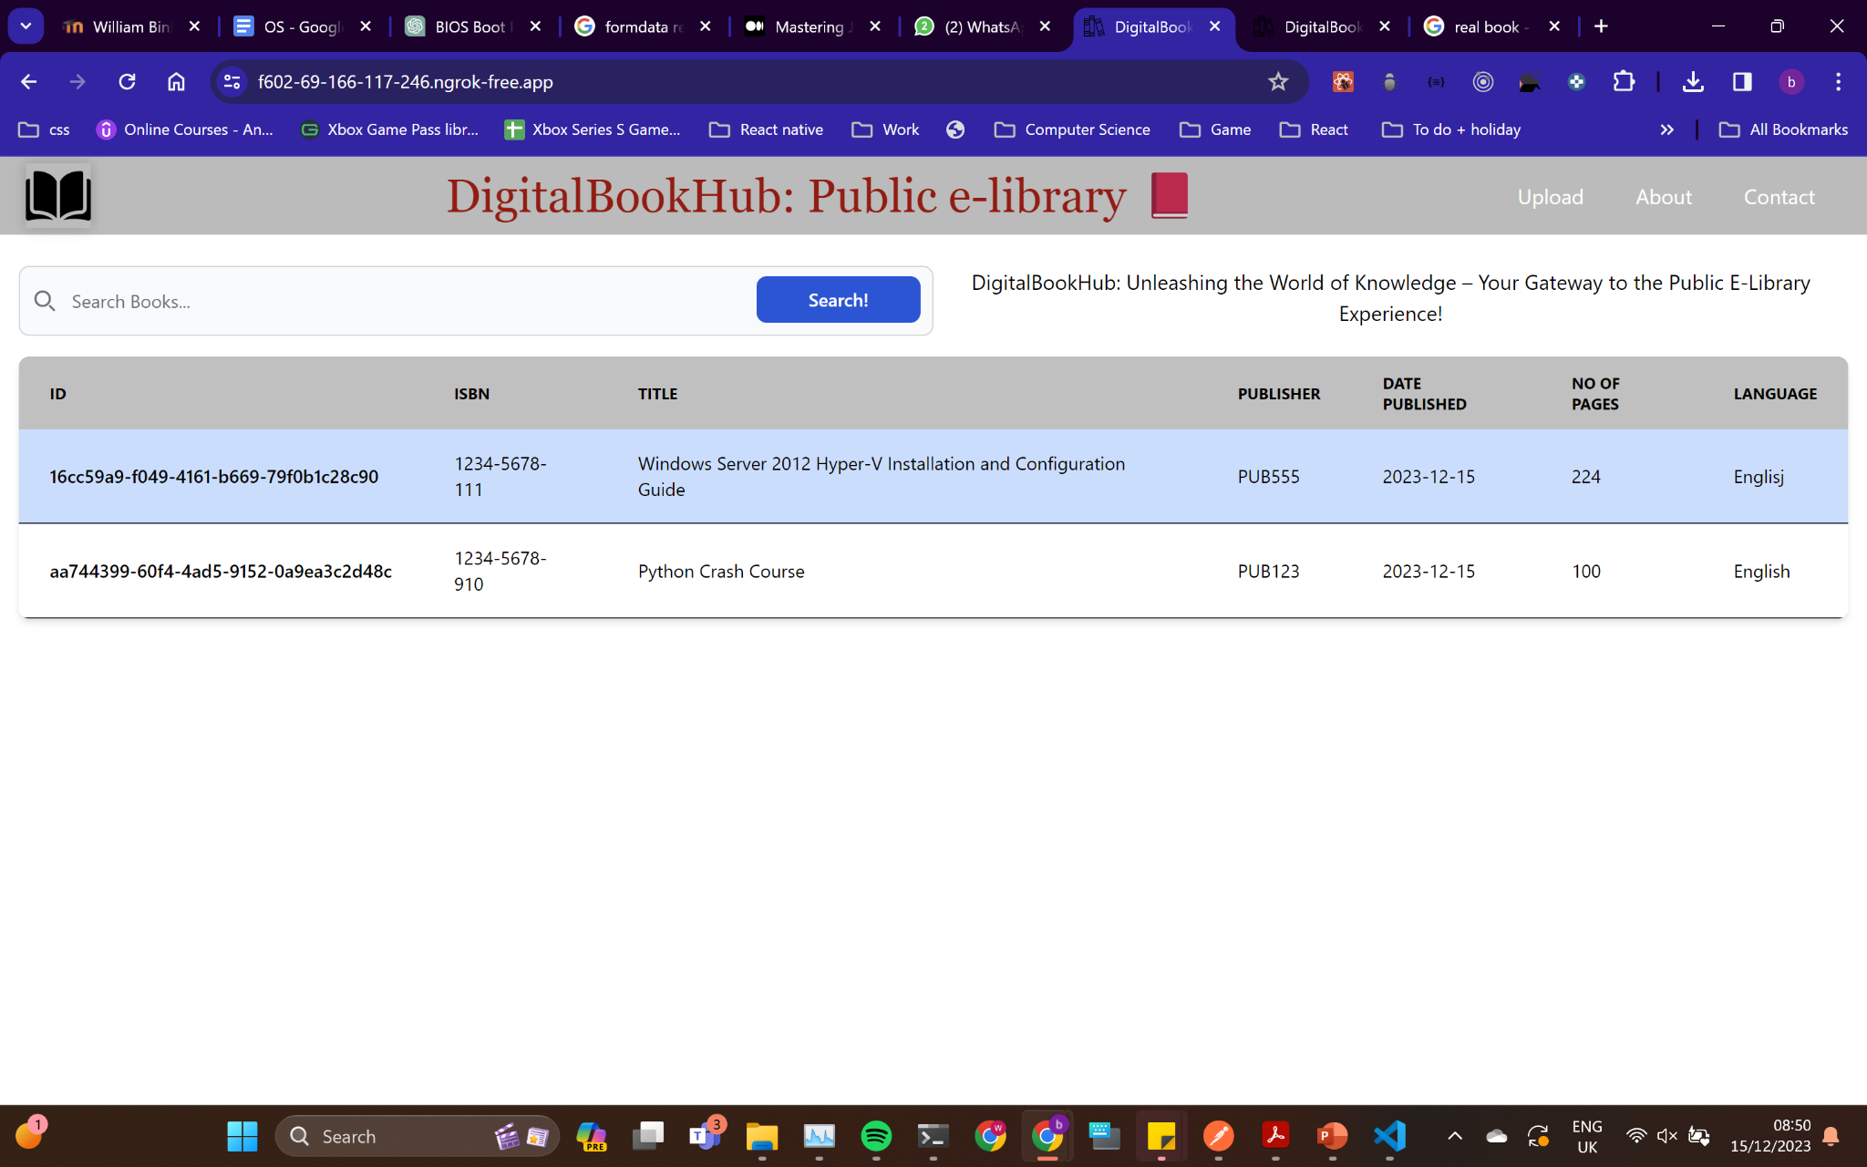
Homepage
Notes:
William

Slide 52
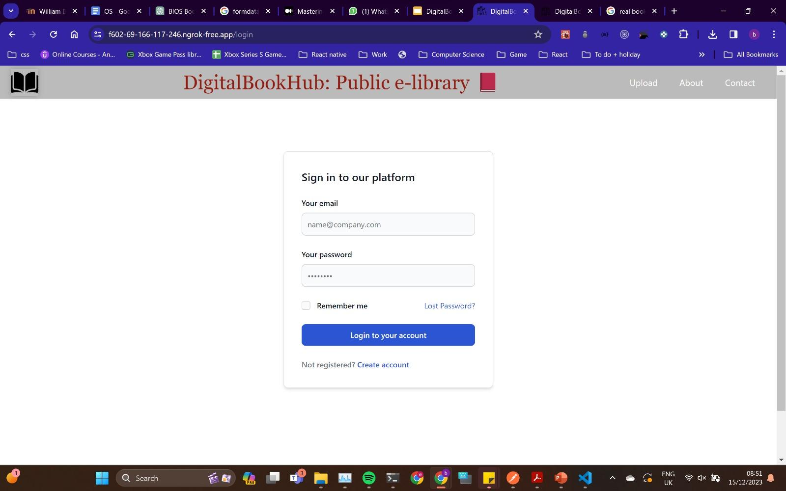
Login page
Notes:
William

Slide 53
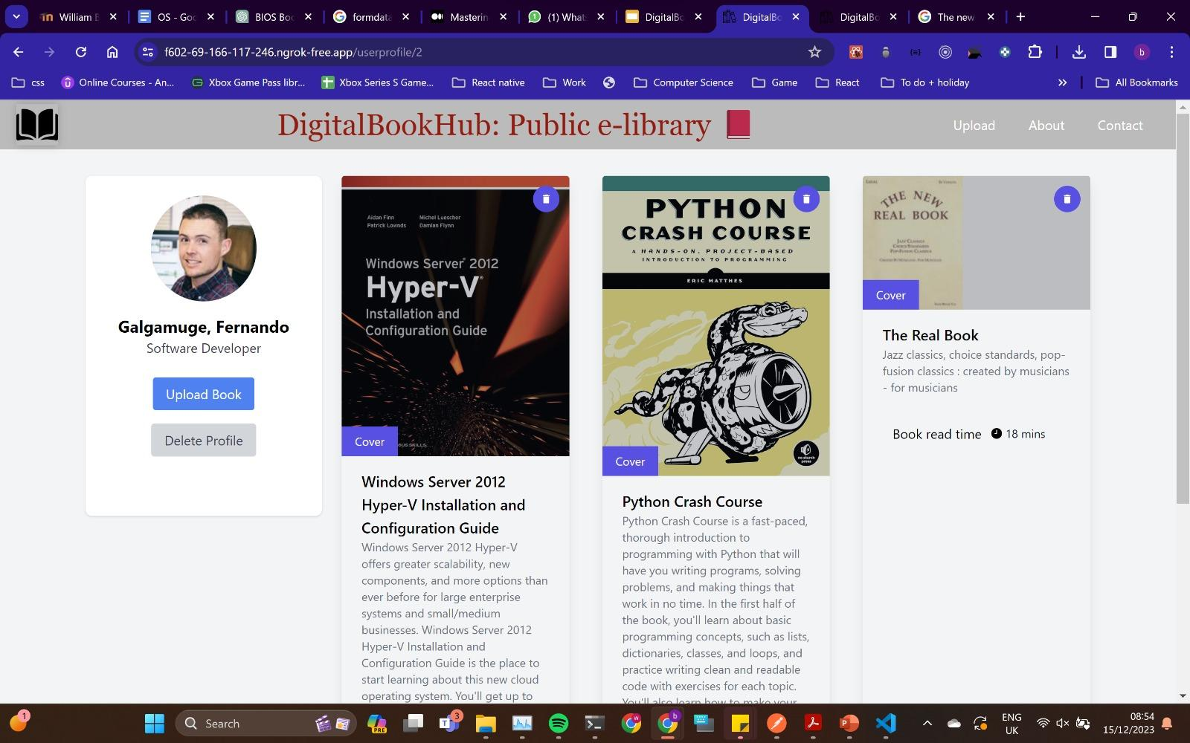
Profile view
Notes:
William

Slide 54
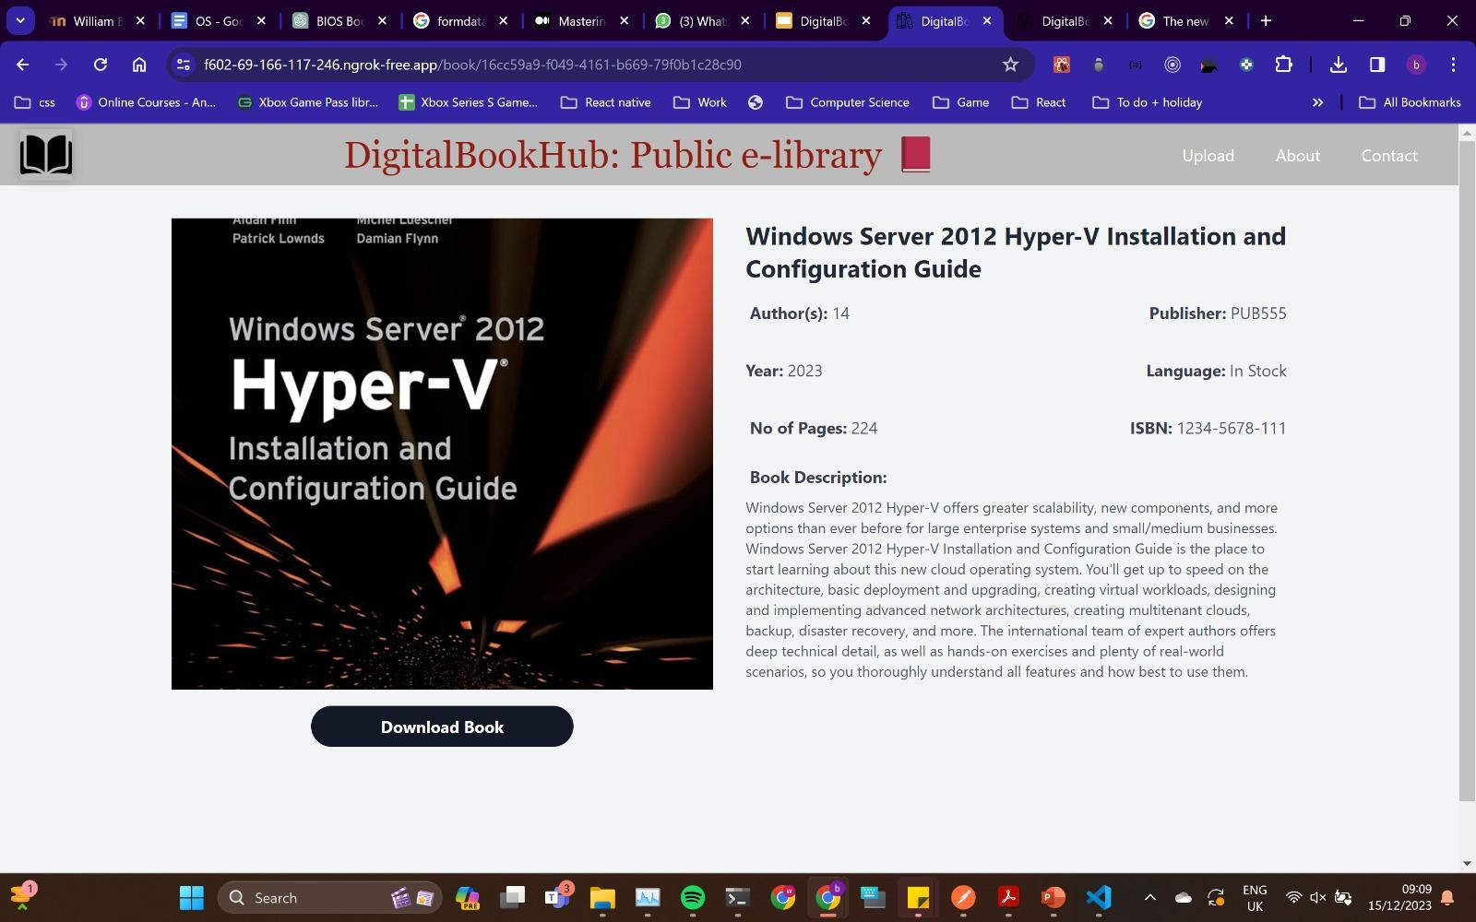
Book
Notes:
William

Slide 55
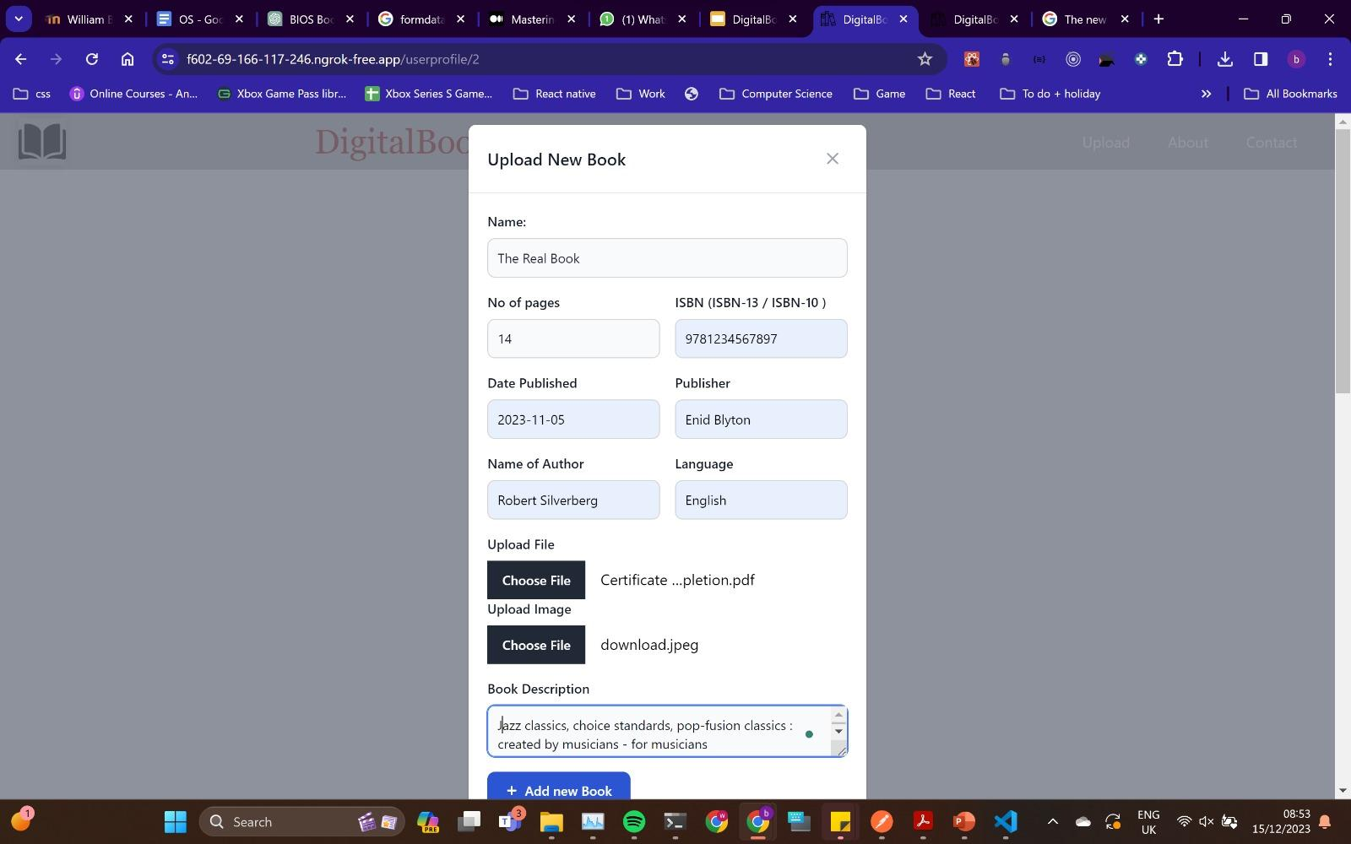
Upload book
Notes:
William

Slide 56
References
http://librarygenesis.rs/
https://www.django-rest-framework.org/
https://legacy.reactjs.org/docs/getting-started.html
Notes:
William

Slide 57

Notes:
William

